Slide 1

INSTITUTE : UIE
DEPARTMENT : CSE
Bachelor of Engineering (Computer Science & Engineering)
Mobile Application Development(20CST-355)
TOPIC OF PRESENTATION:
Android as Competition to itself, Connecting to the Google Play, Android Development Practices, Building an App in Android.
Prepared by:
Parveen Kumar Saini(E13339)
DISCOVER . LEARN . EMPOWER

Slide 2
Android as Competition to itself, Connecting to the Google Play, Android Development Practices, Building an App in Android.

Slide 3
What is a dedicated mobile app?
A dedicated mobile site is a separate version of your website designed exclusively for mobile devices.
How can I make my website compatible with all mobiles?
Implement a Responsive Layout.
Optimize Website Speed.
Subtle Pop-Up Implementation.
Incorporate Viewport Meta tag.
Declutter your Web Design.
Always Test the Website on Real Mobile Devices.
Update Content Carefully.
Do not use Flash.

Slide 4
Why Android is so popular?
Android is affordable and it has all capacities to perform a variety of tasks that a windows or iPhone does.
It is capable of rapidly executing assigned operations.
It supports 3D graphics which enables users to run 3D games as well.
Android interestingly names its operating system after desserts.

Slide 5
What is interesting about Android?
Android is a Mobile Operating System that was released on 23, September 2008.
Android is free, open-source operating system and is based on modified version of Linux kernel.
Open Handset Alliance (OHA) developed the Android and Google commercially sponsored it.

Slide 6
Why do people love Android?
Since Android is an open-source platform, it offers more freedom and customization options than iOS.
You can customize almost anything on your Android device, from how your home screen looks to how you interact with your phone.

Slide 7
Why Android is most popular operating system in the world?
Android is a popular operating system and has a 70% share of the mobile OS market.
Most developers choose Android over any other operating system.
Moreover, it provides an amazing experience to all its end-users which is one of the main reasons for its popularity.

Slide 8
What are the features of Android?
Near Field Communication (NFC) Most Android devices support NFC, which allows electronic devices to interact across short distances easily. ...
Infrared Transmission. ...
Automation. ...
Wireless App Downloads. ...
Storage and Battery Swap. ...
Custom Home Screens. ...
Widgets. ...
Custom ROMs.

Slide 9
Why is it called an Android?
Albertus Magnus allegedly created.
By the late 1700s, "androides", elaborate mechanical devices resembling humans performing human activities, were displayed in exhibit halls.
The term "android" appears in US patents as early as 1863 in reference to miniature human-like toy automatons.

Slide 10
What is Android very short answer?
Android is a mobile operating system based on a modified version of the Linux kernel and other open-source software, designed primarily for touchscreen mobile devices such as smartphones and tablets.

Slide 11
What is the concept of Android?
The Android operating system is a multi-user Linux system in which each app is a different user.
By default, the system assigns each app a unique Linux user ID (the ID is used only by the system and is unknown to the app).

Slide 12
What are the Android new features?
Perhaps one of the most important features when comparing Android 12 vs Android 13 is what's new with privacy and notification.
There are big new features in the form of updates to notifications permissions and privacy,
more control over what apps can send you messages or access your media and clipboard.

Slide 13
What is Android compared to Why?
Google's Android and Apple's iOS are operating systems used primarily in mobile technology, such as smartphones and tablets.
Android, which is Linux-based and partly open source, is more PC-like than iOS, in that its interface and basic features are generally more customizable from top to bottom.

Slide 14
What type of person uses Android?
Both iPhone and Android people are affluent, educated, eager digital device consumers, and well-represented across the adult age spectrum up to 65.
Android people include more hard-core techies: they work in technical jobs and are more comfortable with the more open but less polished Android user experience

Slide 15
Interesting Facts About Android
Android is a Mobile Operating System that was released on 23, September 2008.
Android is free, open-source operating system and is based on modified version of Linux kernel.
Open Handset Alliance (OHA) developed the Android and Google commercially sponsored it.
It is mainly designed for touchscreen devices such as smartphones and tablets.
Android is supported on different platforms like 32- and 64-bit ARM, x86, and x86-64.
Android is available in more than 100 languages with Graphical (multi-touch) as the default user interface.

Slide 16
Journey of ANDROID from first version to latest version:
Android 1.0 (2008) – No Version Name
Android 1.1 2009) – Petit Four
Android 1.5 (2009) – Cupcake
Android 1.6 (2009) – Donut
Android 2.0 – 2.1 (2009) – Éclair
Android 2.2 – 2.2.3 (2010) – Froyo
Android 2.3 – 2.3.7 (2010) – Gingerbread
Android 3.0 – 3.2.6 (2011) – Honeycomb
Android 4.0 – 4.0.4 (2011) – Ice Cream Sandwich
Android 4.1 – 4.3.1 (2012) – Jelly Bean
Android 4.4 – 4.4.4 (2013) – KitKat
Android 5.0 – 5.1.1 (2014) – Lollipop
Android 6.0 – 6.0.1 (2015) – Marshmallow
Android 7.0 – 7.1.2 (2016) – Nougat
Android 8.0 – 8.1 (2017) – Oreo
Android 9.0 (2018) – Pie
Android 10 (2019) – Android 10

Slide 17
Here are some facts about Android :
Android’s creator is Andy Rubin.
Android Inc. developed Android operating system and Google bought it in 2005, with a huge amount of $50 million.
Prior to Google, an offer was given to Samsung to buy Android Inc. but they find Android uninteresting and reject the offer.
Initially, Android was developed as an operating system for digital cameras but later on, it focuses on Smart Phones.
Android is written in many languages like Java, C, C++, XML, Assembly language, Python, Shell script, Go, Make, D.
HTC Dream or T-Mobile G1 was the first smartphone that runs on Android operating system.
HTC Dream or T-Mobile G1 was launched in 2008 with no headphone jack and required an adapter.
Android captures 88% of total smart phone market whereas IOS captures 11% market share.
Currently, more than 2 billion smart devices use Google Android OS as their operating system.

Slide 18
The word Android refers to a male robot, whereas a female robot is known as “Gynoid“.
Android is an open source software, which means its source code is freely available. Anyone can modify the source code and add new & unique features.
All Android versions are named in alphabetical order, along with the name of sweet deserts associated with that alphabet like Cupcake, Donut etc.
The Logging System of Android has a method named as “wtf()” which stands for “What a Terrible Failure”.
In 2010, Anssi Vanjoki, CEO of Nokia, made a hilarious comment on Android. He said the use of Android is like a Finnish boy peeing his pants to stay warm.
Android’s Google Store has more than 48 billion apps installed in it, and most of them are free of cost.
NASA once used Nexus S handsets (device based on Android Gingerbread), in their floating space Robots.
The sale of Android devices is more than the combined sale of Microsoft Windows, iOS, and Mac OS devices.
Microsoft earns around $2 billion yearly in patent royalties, from the sale of Android devices.
Even Google Maps uses the speed of Android Mobiles to calculate the traffic on roads.
Google had to made a deal with Nestle in order to use the name “Kit-Kat” for Android version 4.4.

Slide 19
Why We Need Android Alternative?
With around 72% market share, Android has become a monopoly in the mobile operating system market. There is not much choice for consumers, except to choose an Android device or go for the pricier iPhone. In such a scenario, we need more alternatives to accelerate innovation, bring more choices to consumers, add better privacy standards, and more. For the past many years, Android’s security has been lackluster. After Android 8, Google got serious about hardening the security of Android and closing the loopholes. In fact, in earlier Android days, there was no concept of runtime permission.
Currently, Android is on a course-correction phase where it’s bringing much-needed security features and privacy controls. Apple is forcing Google to bring privacy insights of apps, restricting apps from accessing clipboards, permission reminders, and so on. These are essential privacy features that are available on other mobile platforms for many years. Even today, we don’t have a user-facing network permission toggle on Android. Third-party apps can regularly scan all your installed apps, access your clipboard, and so on.

Slide 20
While Android is fixing some of these issues, most users are not getting the updates due to fragmentation. Google tried to resolve the fragmentation problem with Project Treble, but the truth is that, except for some manufacturers, not many are offering longer security and feature updates. To combat this situation and to put consumers on the safer side, we need an Android alternative that respects your privacy, does not trade user data for cheaper hardware, and comes with stronger security.

Slide 21
Best Android Alternative Mobile Operating Systems
1. iOS
With a 27.5% market share, iOS is slowly becoming the mainstream alternative to Android. Gone are the days when Android was feature-packed and iOS was for average users. iOS now comes with advanced features such as Shortcuts for automation, SharePlay to co-watch movies and shows with your friends and family, live text translation, and more. Siri is also getting quite better and the ecosystem support from various Apple devices is unparalleled in the Android world.
Not to mention, iOS is much more respectful of your privacy in comparison to Android. Recently, Apple added privacy report to the App Store where it displays all the user data the app is trying to collect. It also lets you request apps to disable tracking which is a great privacy feature to have. iOS is also simpler to use, although Google is working on Android to make it more accessible to a varied group of users. To sum up, if you want peace of mind with top-notch privacy and security, along with a legion of handy iOS features, Apple’s iOS positions itself as a suitable alternative to Android.

Slide 22
Pros | Cons
Beautiful UI, Smooth operation, easier to use | Not open-source
Much longer updates | Devices are costly
Great quality of apps | Limited customization

Slide 23
2. GrapheneOS
If security and privacy are your main reasons behind your search for an Android alternative, GrapheneOS fits the bill perfectly. It’s a security-hardened operating system, built with top-notch privacy protection in mind. GrapheneOS, earlier known as CopperheadOS, is also developed on Android, but the main developer, Daniel Micay has worked extensively to make GrapheneOS a completely secure mobile operating system. Even Edward Snowden endorsed GrapheneOS and said that “If I were configuring a smartphone today, I’d use Daniel Micay’s GrapheneOS as the base operating system“.
Currently, it only supports Pixel devices including the latest Pixel 6 series. GrapheneOS has deployed major technologies to restrict a number of vulnerabilities and exploits. The app sandbox feature makes it harder for malware to attack your smartphone. There are additional permissions as well including network permission, sensors permission, USB access, camera access, and more.

Slide 24
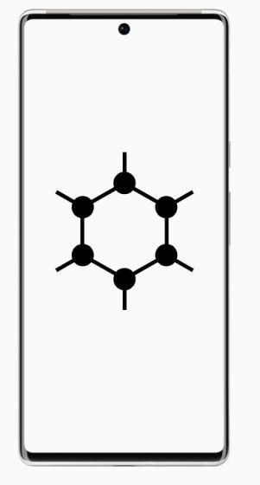
Other than that, GrapheneOS ships with a hardened variant of Chromium called Vanadium for browsing the web, there is a security-focused PDF viewer, a secure camera app, Seedvault for encrypted backup, and a lot more. Not to mention, it does not ship with Google Play Services or microG, making it a completely deGoogled Android fork. All in all, if you are looking for a secure alternative to Android, GrapheneOS would be my top recommendation.
Pros | Cons
Top-notch security and privacy protection | Limited device support
Based on Android
First-party apps available

Slide 25
3. KaiOS
For feature phones, KaiOS is a great alternative to Android. We know that Android has become quite heavy at this point. So to bring a lightweight mobile operating system to the masses, KaiOS serves the purpose really well without missing out on major features. It’s a Linux-based OS, forked from the discontinued Firefox OS, and can run on devices with just 256MB of RAM.
KaiOS packs its own KaiStore where you can find over 500 apps which include WhatsApp, YouTube, Facebook, Google Assistant, Google Maps, Google app, UC Browser, lightweight games, and more. There are hundreds of models available around the globe and the starting price of these phones is just $10 which is amazing. In India, JioPhone is quite popular which costs around $20-25 and runs KaiOS. To sum up, KaiOS is a perfect alternative to Android in regions where affordability is preferred over a long list of features.

Slide 26
Pros | Cons
Lightweight OS, a forked version of Firefox OS | Not for the main Android smartphone market
Supports Web-based apps
Continually updated

Slide 27
4. Sailfish OS
Sailfish OS has been one of the oldest alternatives to Android, competing and developing a mobile operating system since 2013. It is currently in its 4th generation and is being actively developed by a Finnish company Jolla Ltd. Sailfish OS has been built on top of Linux along with many other open-source projects. While it’s not built on Android, Sailfish OS can run Android apps using its dedicated App Support solution. And that’s one of the selling points of Sailfish OS.
In Sailfish OS, user data is fully encrypted by its sandboxing solution called Firejail. All the connectivity and traffic runs behind a firewall with support for VPN. In terms of security, Sailfish OS is quite good and the company is making an investment to make it even more secure. Apart from all that, Sailfish OS has a distinct visual style and the gesture-based apps are fun to use. You can try Sailfish OS on Sony Xperia phones and Gemini PDA.

Slide 28
Pros | Cons
The visual style is quite good, gesture navigation | A bit buggy
Can run Android apps via a layer | Not as performant as Android
Built-in VPN and sandboxing

Slide 29
5. Plasma Mobile / postmarketOS
Unlike many other Android forks, Plasma Mobile is an Android alternative that runs on top of a Linux distribution. It has been developed using the multi-platform toolkit Qt and KDE framework that powers so many Linux distros out there. To make the skin look fluid and mobile, it uses a Plasma Shell that feels polished out of the box. Note that, it does not run Android apps, instead uses the Kirigami UI framework to create apps for Plasma Mobile. Using Plasma Mobile, many Linux distros for phones have been released, but the most popular one is postmarketOS.\
It already comes with a lot of alternative apps, built on Kirigami such as Calculator, Angelfish Web browser, AudioTube (a YouTube music client), Calindori (Calendar), Elisa (Music Play), Index (File Manager), and more. In essence, Plasma Mobile is one of the true alternatives to Android that is built on a completely different framework and has a different package manager. Currently, it supports PinePhone, Purism Librem 5, and community-supported devices like OnePlus 6, PocoPhone, etc. So if you are looking to try something new, go ahead and install Plasma Mobile on your smartphone.

Slide 30
Pros | Cons
Linux-based OS | No Android apps
Developed Mobile shell using new frameworks
First-party apps available

Slide 31
6. Ubuntu Touch
Ubuntu Touch is another Linux-based alternative to Android that is focused on bringing trust and privacy to smartphones. As the project is open-source, it has a huge community of developers and users who want to test, experiment, and contribute to the project. Ubuntu Touch feels and looks very identical to the Ubuntu desktop OS, however, it has been heavily optimized for touchscreen operations.
The UBports community also claims that none of your data leaves your device unless you explicitly allow it which is a good thing from the privacy point of view. Currently, Ubuntu Touch supports PinePhone, PineTab, Fairphone, Volla, Nexus 5, and OnePlus One. There are also 81 devices that are community supported so in terms of device support, Ubuntu Touch excels. Not to mention, you get all the necessary apps including the Camera app, Music, Gallery, Terminal, Clock, Dialer, etc. I would say if you want to try an open-source OS similar to Android, do give a look at Ubuntu Touch.

Slide 32
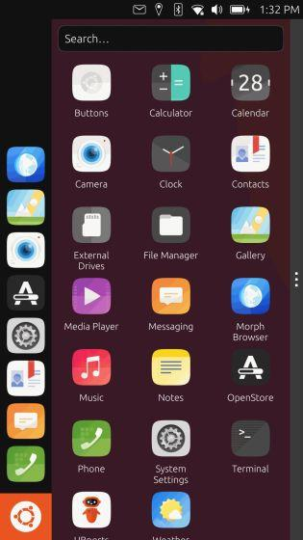
Pros | Cons
Open-source operating system, based on Linux | Cannot match the third-party app support of Android
Comes with all the basic apps
Can function as a desktop

Slide 33
7. Mobian
Mobian, as the name suggests, is a Debian-based operating system for mobile devices. Currently, it does not support a whole list of devices, but Mobian can run on PinePhone, Poco F1, OnePlus 6, and some more devices. Unlike Android, it runs Linux apps and the UI is surprisingly good. It comes with all the basic apps including a Calculator, Camera, Call, Settings, and more. There is also Terminal support, in case you want to dive deep into the system.
Needless to say, it does not support Android apps and the app support is limited. However, Mobian sets out to bring an alternative mobile OS to Android which is quite nice. Mobian uses Phosh, a mobile shell built by Purism, and deploys well-known frameworks like Gnome and GTK. All in all, I would say, Mobian is a potential alternative to Android and you can definitely give it a try.

Slide 34
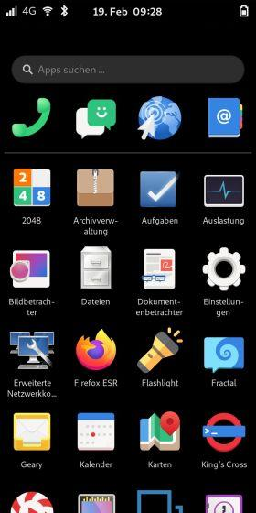
Pros | Cons
Mobile derivative from Debian | Limited app support
Popular device support
Built on Phosh, Gnome, and GTK

Slide 35
8. Tizen OS
If you are looking for an alternative to Android for larger screens such as TVs then Tizen OS is a better choice. Developed by Samsung, Tizen OS was aimed to run on all Samsung devices, be it smartphones, wearables, IoT devices, TVs, etc. However, fast forward now, and we are noticing Samsung is embracing Android for all its products except for the TV segment. Samsung has stopped developing phones with Tizen OS and recently, on Galaxy Watch 4, it moved to Wear OS from Tizen OS.
Having said all of that, for smart TVs, Samsung continues to use its Tizen OS as the project has gotten popular and lots of third-party apps have been launched including Netflix, Prime Video, etc. We have detailed a dedicated comparison between Android TV and Tizen OS so go through our article to learn more about the differences. To make it clear, as far as smart TVs are concerned, Tizen OS rules the roost and is more performant than Android TV, even on low-end hardware.

Slide 36
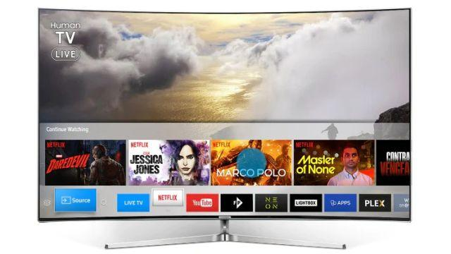
Pros | Cons
Great HTML5 support | Third-party app support is limited
Better performance than Android TV
Best for the TV ecosystem

Slide 37
9. CalyxOS
CalyxOS is another privacy-focused alternative to Android which is completely deGoogled and puts a major focus on hardening security and privacy. It has been built by the Calyx Institute which is a New York-based nonprofit organization to make digital security more accessible to the masses. CalyxOS currently supports a handful of Pixel and OnePlus devices and Xiaomi Mi A2, but support for more devices will be added soon.
It ships with Signal for encrypted messaging; Tor browser to access the web without any tracking; a free and trusted VPN from the Calyx Institute; the open-source Aurora Store, a Play Store alternative, and more. There are no Google services included in CalyxOS but if you want, you can sideload microG to get some of the Google services without sacrificing your anonymity. To sum up, if privacy is what you are looking for on your smartphone, CalyxOS is a great alternative to other Android forks.

Slide 38
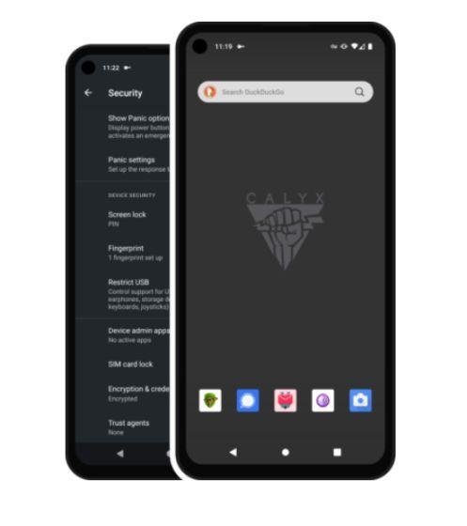
Pros | Cons
Privacy-centric OS, Based on Android | Limited device support
Many security features include VPN, Tor, etc.
No Google Services

Slide 39
10. LineageOS
If your Android smartphone has hit end-of-life and no longer receives OTA updates from the manufacturer, LineageOS will come to your rescue. It’s a custom Android ROM, not much different from the standard Android that you are running on your device, however, you get to taste the latest Android version, even when the manufacturer is no longer supporting your device.
On top of that, LineageOS comes clean without Google services. You can, however, sideload the GApps package and get Play Store and other services running. It supports more than 200 devices and continuously brings the latest updates to outdated hardware. Even many custom ROMs fork LineageOS to add more functionality and features due to its rock-solid base. LineageOS has even brought the latest Android 12 update to more than 41 devices which is amazing. Simply put, LineageOS, despite being an Android fork, is a go-to alternative because of long-life support, better performance, and no Google bloatware.

Slide 40
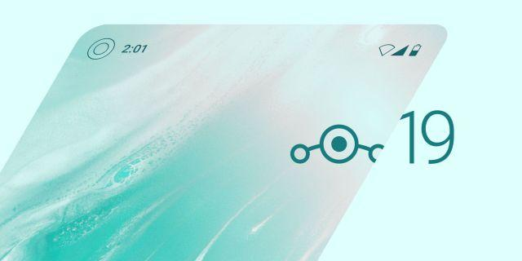
Pros | Cons
Based on Android AOSP, Supports Android 12 | None as such
Supports a long list of devices

Slide 41
11. /e/ OS
After GrapheneOS and CalyxOS, if you want another alternative to Android that is highly secure and private then you can try /e/ OS. It’s also based on Android (LineageOS), but the operating system has been completely deGoogled and there are alternative apps in place of popular Google apps. You can install apps from its own store and it even displays privacy and energy ratings, similar to iOS’ AppStore.
/e/ OS is completely open-source and has been developed by the non-profit /e/ Foundation which is based in France. Currently, it supports more than 240 smartphone models which include popular Samsung phones and some Fairphone models. You can also buy smartphones preloaded with /e/ OS from its website. Overall, /e/ OS is a great solution for users who are looking to buy a privacy-focused smartphone but without Google lurking from behind.

Slide 42
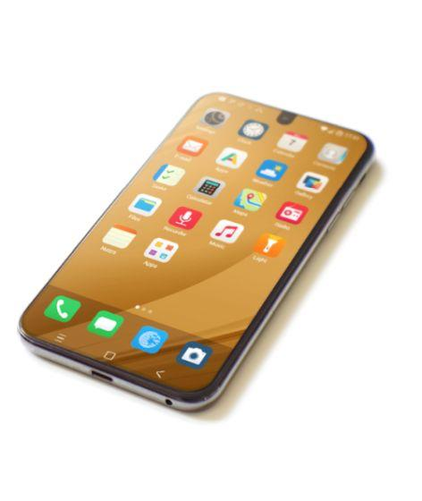
Pros | Cons
deGoogle Android fork, based on LineageOS | /e/ preloaded smartphones are a bit expensive
Vast device support
Privacy rating in app store

Slide 43
12. HarmonyOS
After the US ban, Huawei had no recourse but to develop its own operating system for smartphones and other devices. The company developed HarmonyOS which is basically a fork of vanilla AOSP so essentially it runs Android under the hood. That said, Huawei has developed its own app packaging container called APP. You can also sideload APKs on HarmonyOS which is awesome.
It also comes with its own AppGallery where you can find thousands of popular Android apps. The company has also developed its own compiler called ARK in place of Android’s ART (Android Runtime). And the new EROFS file system is said to be better than EXT4 and F2FS. While HarmonyOS is deep inside an Android OS, chances are that Huawei will come up with an alternative to Android in upcoming years. The company is due to release HarmonyOS 3.0 in September with new APIs and SDK.

Slide 44
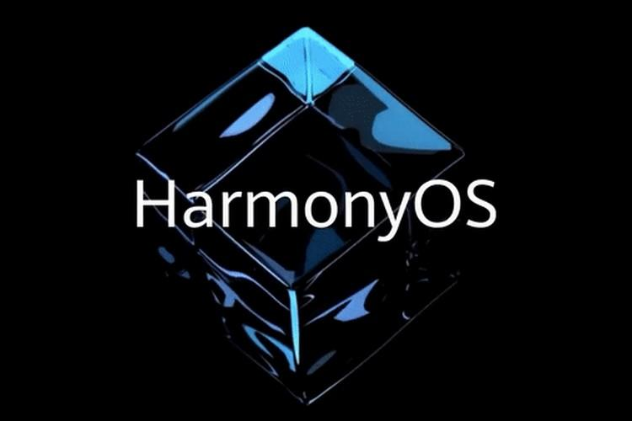
Pros | Cons
Supports APK sideloading | The core is still Android, uses the AOSP base
Suitable OS for Huawei ecosystem
Developed its own APP package manager

Slide 45
How do I fix connecting to Google Play com?
Basic troubleshooting steps
Check that you have a strong Wi-Fi or mobile data connection.
Check your storage space.
Check for Android system updates.
Close & reopen the Play Store.
Uninstall & reinstall Play Store updates.
Restart your device.
Clear cache & data from Google Play Services.
Remove & re-add your Google Account.

Slide 46
How to Use Google Play Install Referrer API in Android?
Google Play Install Referrer is the API that is used in most of the applications but it is not been seen in the app. This functionality works under the hood and is used to check the sources from where the app is getting most of the downloads. Google Play Install Referrer API tells us that from where the app has to go installs and the sources. This will helps us to improve the presence of our apps on different platforms.

Slide 47
What is the use of Google Play Referrer API?
Google Play Referrer API provides us information from where our app has been installed whether it may be play store or any other platform.
With the help of this API, we can track the actions which are taken by the user to download our App. Below are some of the important data which we can gather using this API. With the help of this API, we can track from where the user has installed our application.
We can get the URL from which our app has been downloaded. We can get the timestamp when the user clicks on the referrer URL.
We can get the timestamp of the user when the user downloads our app from a specific URL. We can get the app version when our app was first installed.
We can track whether the user has used the app’s instant experience with the previous 7 days.

Slide 48
What we are going to build in this article?
We will be building a simple application in which we will be adding our Google Play Referrer API and we will be displaying the data which is tracked by this API in a simple text view. Note that as we have not published our App to Google Play. So we will only get the source from which our app installed as organic. Below is the screenshot in which we will get to see what we are going to build in this article. Note that we are going to implement this project using the Java language.

Slide 49
THANK YOU
For queries
Email: parveen.e13339@cumail.in

